Slide 1
Chapter 3: Branch Connections
Instructor Materials
CCNA Routing and Switching
Connecting Networks v6.0
Notes:
Cisco Networking Academy Program
Connecting Networks v6.0
Chapter 3: Branch Connections

Slide 2
Instructor Materials – Chapter 3 Planning Guide
This PowerPoint deck is divided in two parts:
Instructor Planning Guide
Information to help you become familiar with the chapter
Teaching aids
Instructor Class Presentation
Optional slides that you can use in the classroom
Begins on slide # 13
Note: Remove the Planning Guide from this presentation before sharing with anyone.
Notes:
2

Slide 3
Chapter 3: Branch Connections
Connecting Networks v6.0 Planning Guide
Notes:
Cisco Networking Academy Program
Connecting Networks v6.0
Chapter 3: Branch Connections

Slide 4
Chapter 3: Activities
What activities are associated with this chapter?
Page # | Activity Type | Activity Name | Optional?
3.0.1.2 | Class Activity | Broadband Varieties | Optional
3.1.1.6 | Interactive Activity | Identify Broadband Connection Terminology | Recommended
3.1.2.2 | Lab | Researching Broadband Internet Access Technologies | Optional
3.2.2.1 | Syntax Checker | Configuring PPPoE | Recommended
3.2.2.7 | Lab | Configuring a Router as a PPPoE Client for DSL Connectivity | Recommended
3.2.2.8 | Lab | Troubleshoot PPPoE | Recommended
3.3.1.3 | Interactive Activity | Identify Benefits of VPNs | Recommended
3.3.2.4 | Interactive Activity | Compare Types of VPNs | Recommended
3.4.1.3 | Interactive Activity | Identify GRE Characteristics | Recommended
3.4.2.2 | Syntax Checker | Configure and Verify a GRE Tunnel | Recommended
The password used in the Packet Tracer activities in this chapter is: PT_ccna5
Notes:
4

Slide 5
Chapter 3: Activities
What activities are associated with this chapter?
Page # | Activity Type | Activity Name | Optional?
3.4.2.4 | Packet Tracer | Configuring GRE | Recommended
3.4.2.5 | Packet Tracer | Troubleshooting GRE | Recommended
3.4.2.6 | Lab | Configuring a Point-to-Point GRE VPN Tunnel | Optional
3.5.2.4 | Interactive Activity | Identify BGP Terminology and Designs | Recommended
3.5.3.3 | Syntax Checker | Configure and Verify eBGP | Recommended
3.5.3.4 | PacketTracer | Configure and Verify eBGP | Optional
3.5.3.5 | Lab | Configure and Verify eBGP | Recommended
3.6.1.1 | Class Activity | VPN Planning Design | Optional
3.6.1.2 | Packet Tracer | Skills Integration Challenge | Recommended
3.6.1.3 | Lab | Configure a Branch Connection | Optional
The password used in the Packet Tracer activities in this chapter is: PT_ccna5
Notes:
5

Slide 6
Chapter 3: Assessment
Students should complete Chapter 3, “Assessment” after completing Chapter 3.
Quizzes, labs, Packet Tracers and other activities can be used to informally assess student progress.
Notes:
6

Slide 7
Chapter 3: Best Practices
Prior to teaching Chapter 3, the instructor should:
Complete Chapter 3, “Assessment.”
The objectives of this chapter are:
Compare remote access broadband connection options for small to medium-sized businesses.
Select an appropriate broadband connection for a given network requirement.
Explain how PPPoE operates.
Implement a basic PPPoE connection on a client router.
Describe benefits of VPN technology.
Describe site-to-site and remote access VPNs.
Explain the purpose and benefits of GRE tunnels.
Troubleshoot a site-to-site GRE tunnel.
Describe basic BGP features.
Explain BGP design considerations.
Configure an eBGP branch connection.
Notes:
7

Slide 8
Chapter 3: Best Practices (Cont.)
3.1
Discuss the broadband options in your area.
Highlight the advantages and disadvantages of cable, DSL and broadband wireless.
There are many new terms and acronyms in this chapter. Emphasize these new terms when presenting this material. See list of new terms at the end of this PowerPoint.
Consider assigning part 2 of the Lab - Researching Broadband Internet Access Technologies to small groups and have them present results to class.
3.2
Point out that PPP is the primary protocol used for serial connections.
PPP gives the ISP the ability to assign IP addresses to remote ends of a PPP link and supports authentication.
Ethernet does not support PPP so PPPoE is the solution.
Review the configuration of PPPoE on 3.2.2.1 explaining the purpose of each command. Have students complete the syntax checker before doing the labs.
Review the specific PPPoE verification and troubleshooting commands and output: show interface dialer, show pppoe session, debug ppp negotiation.
Notes:
8

Slide 9
Chapter 3: Best Practices (Cont.)
3.3
Discuss the benefits of VPNs
Differentiate between a site-to-site VPN (connecting network to network) and remote access VPN (user to network).
3.4
Make sure students understand that Generic Routing Encapsulation (GRE) is one example of a basic, non-secure, site-to-site VPN tunneling protocol for transporting multiprotocol and IP multicast traffic. The tunnels are comprised of three main components Delivery Header (Transport Protocol), GRE Header (Carrier Protocol), Payload Packet (Passenger Protocol). Use activity 3.4.1.3 to show each of these.
Create a Packet Tracer to demonstrate the commands to create a GRE tunnel and the commands to verify and troubleshoot.
Students should complete the recommended lab and the optional Packet Tracers if time permits.
3.5
Remind students about the features of Interior Gateway protocols they have already worked with and compare to BGP, an Exterior Gateway protocol.
Notes:
9

Slide 10
Chapter 3: Best Practices (Cont.)
3.5 (Cont.)
When discussing when to use BGP, explain the concept of single-homed ( a single connection to the Internet or one AS) and multi-homed (connections to multiple autonomous systems).
Make sure students know the difference between iBGP and eBGP
Recommend that students complete the Interactive activity, 3.5.2.4 Identify BGP Terminology, to become more comfortable with new BGP terms.
Create a topology in Packet Tracer to demonstrate configuration and verification of eBGP (use the sample configuration in 3.5.3.2).
Students should complete the recommended lab and the optional Packet Tracer if time permits.
Notes:
10

Slide 11
Chapter 3: Additional Help
For additional help with teaching strategies, including lesson plans, analogies for difficult concepts, and discussion topics, visit the CCNA Community at: https://www.netacad.com/group/communities/community-home
Best practices from around the world for teaching CCNA Routing and Switching. https://www.netacad.com/group/communities/ccna
If you have lesson plans or resources that you would like to share, upload them to the CCNA Community in order to help other instructors.
Students can enroll in Introduction to Packet Tracer (self-paced)
Notes:
11

Slide 13
Chapter 3: Branch Connections
CCNA Routing and Switching
Connecting Networks v6.0
Notes:
Cisco Networking Academy Program
Connecting Networks v6.0
Chapter 3: Branch Connections

Slide 14
Chapter 3 - Sections & Objectives
3.1 Remote Access Connections
Select broadband remote access technologies to support business requirements.
Compare remote access broadband connection options for small to medium-sized businesses.
Select an appropriate broadband connection for a given network requirement.
3.2 PPPoE
Configure a Cisco router with PPPoE.
Explain how PPPoE operates.
Implement a basic PPPoE connection on a client router.
3.3 VPNs
Explain how VPNs secure site-to-site and remote access connectivity.
Describe benefits of VPN technology.
Describe site-to-site and remote access VPNs.
Notes:
14
Cisco Networking Academy Program
Connecting Networks v6.0
Chapter 3: Branch Connections

Slide 15
Chapter 3 - Sections & Objectives (Cont.)
3.4 GRE
Implement a GRE tunnel.
Explain the purpose and benefits of GRE tunnels.
Troubleshoot a site-to-site GRE tunnel.
3.5 eBGP
Implement eBGP in a single-homed remote access network.
Describe basic BGP features.
Explain BGP design considerations.
Configure an eBGP branch connection.
Notes:
15
Cisco Networking Academy Program
Connecting Networks v6.0
Chapter 3: Branch Connections

Slide 16
3.1 Remote Access Connections
Notes:
3 – Branch Connections
3.1 – Remote Access Connections

Slide 17
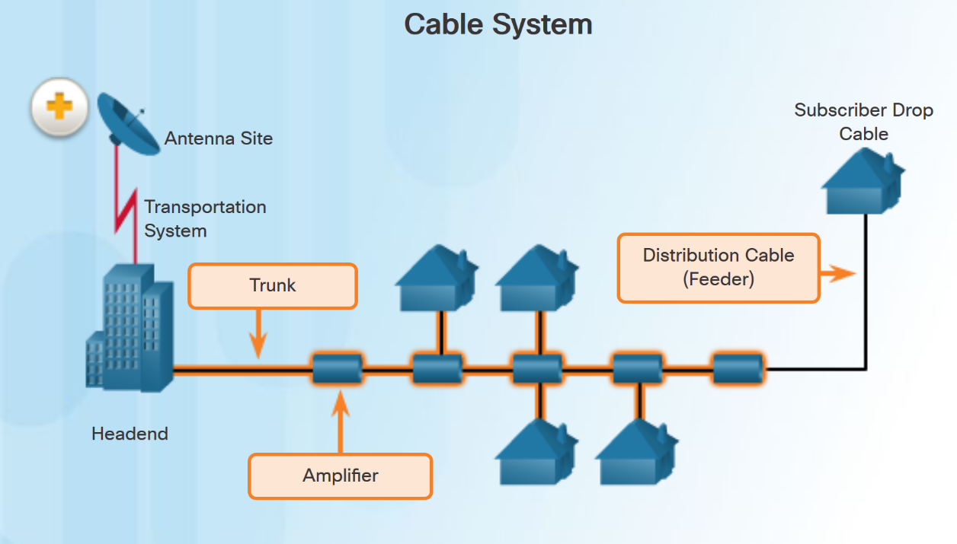
Broadband Connections What is a Cable System?
Cable system uses a coaxial cable that carries radio frequency (RF) signals across the network.
Cable systems provide high-speed Internet access, digital cable television, and residential telephone service.
Use hybrid fiber-coaxial (HFC) networks to enable high-speed transmission of data.
Notes:
3.1 – Remote Access Connections
3.1.1 – Broadband Connections
3.1.1.1 – What is a Cable System?

Slide 18
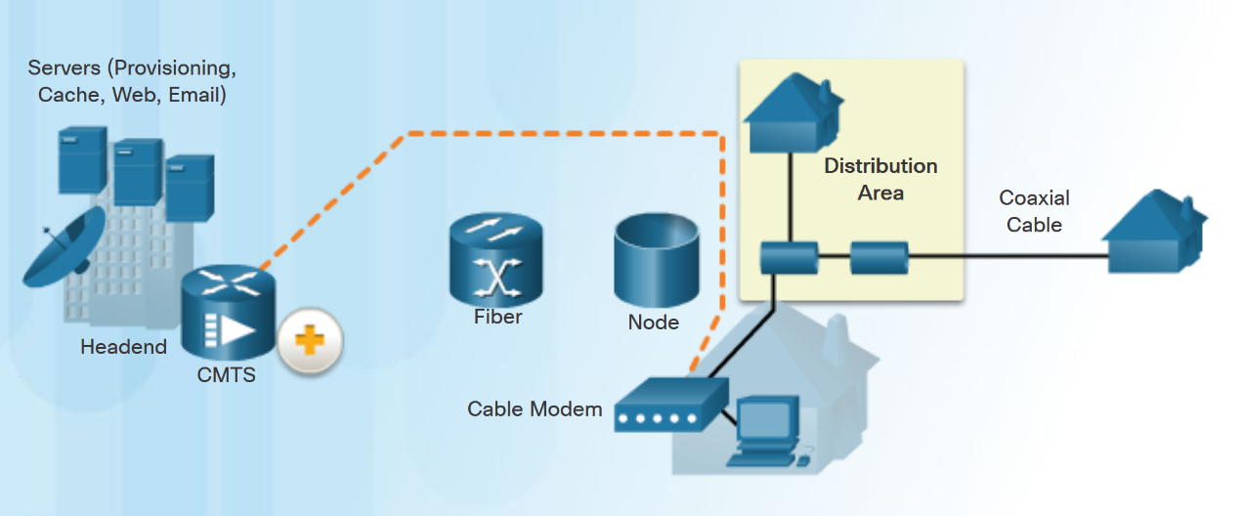
Broadband Connections Cable Components
Two types of equipment are required to send signals upstream and downstream on a cable system:
Cable Modem Termination System (CMTS) at the headend of the cable operator. The headend is a router with databases for providing Internet services to cable subscribers.
Cable Modem (CM) on the subscriber end.
Notes:
3.1 – Remote Access Connections
3.1.1 – Broadband Connections
3.1.1.2 – Cable Components

Slide 19
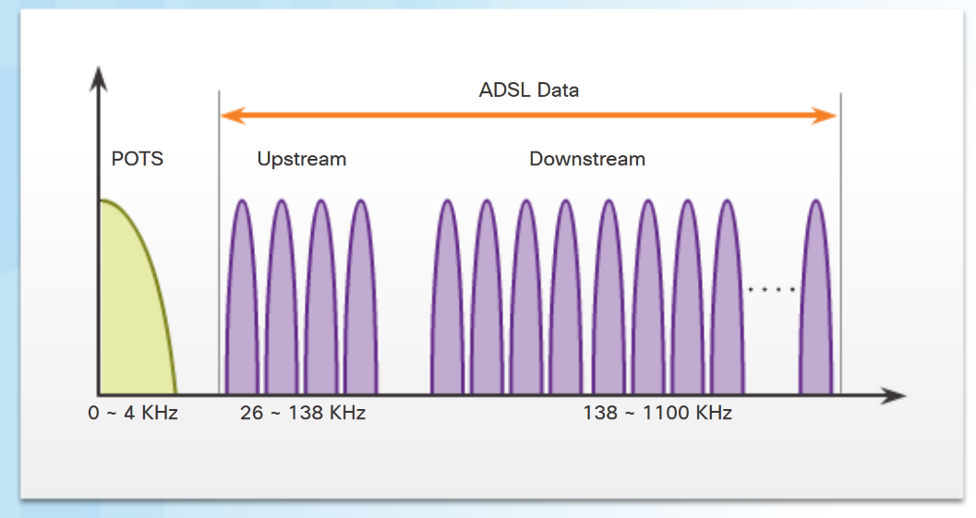
Broadband Connections What is DSL?
Digital Subscriber Line (DSL) is a means of providing high-speed connections over installed copper wires.
Asymmetric DSL (ADSL) provides higher downstream bandwidth to the user than upload bandwidth.
Symmetric DSL (SDSL) provides the same capacity in both directions.
For satisfactory ADSL service, the local loop length must be less than 3.39 miles (5.46 km).
The figure shows a representation of bandwidth space allocation on a copper wire for ADSL. POTS (Plain Old Telephone System) identifies the frequency range used by the voice-grade telephone service. The area labeled ADSL represents the frequency space used by the upstream and downstream DSL signals.
Notes:
3.1 – Remote Access Connections
3.1.1 – Broadband Connections
3.1.1.3 – What is DSL?

Slide 20
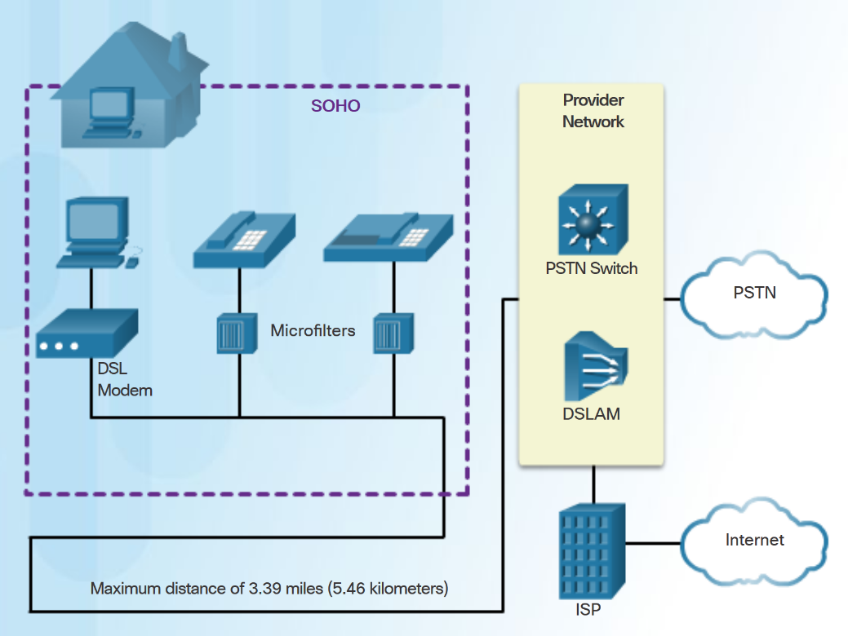
Broadband Connections DSL Connections
The DSL connection is set up between the customer premises equipment (CPE) and the DSL access multiplexer (DSLAM) device located at the Central Office (CO).
Key components in the DSL connection:
Transceiver - Usually a modem in a router which connects the computer of the teleworker to the DSL.
DSLAM - Located at the CO of the carrier, it combines individual DSL connections from users into one high-capacity link to an ISP.
Advantage of DSL over cable technology is that DSL is not a shared medium. Each user has a separate direct connection to the DSLAM.
Notes:
3.1 – Remote Access Connections
3.1.1 – Broadband Connections
3.1.1.4 – DSL Connections

Slide 21
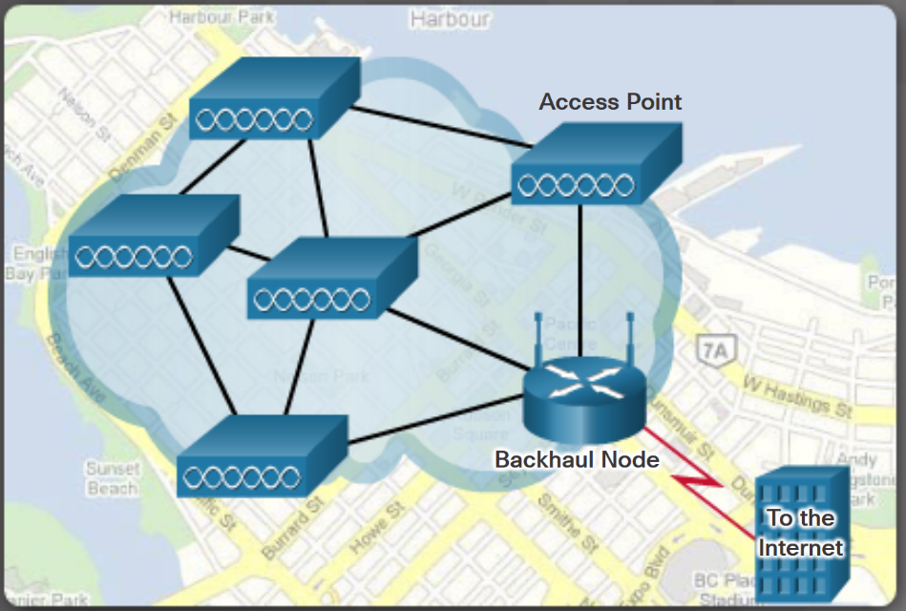
Broadband Connections Wireless Connection
Three main broadband wireless technologies:
Municipal Wi-Fi - Most municipal wireless networks use a mesh of interconnected access points as shown in figure.
Cellular/mobile - Mobile phones use radio waves to communicate through nearby cell towers. Cellular speeds continue to increase. LTE Category 10 supports up to 450 Mb/s download and 100 Mb/s upload.
Satellite Internet - Used in locations where land-based Internet access is not available. Primary installation requirement is for the antenna to have a clear view toward the equator.
Note: WiMAX has largely been replaced by LTE for mobile access, and cable or DSL for fixed access.
Notes:
3.1 – Remote Access Connections
3.1.1 – Broadband Connections
3.1.1.5 – Wireless Connection

Slide 22
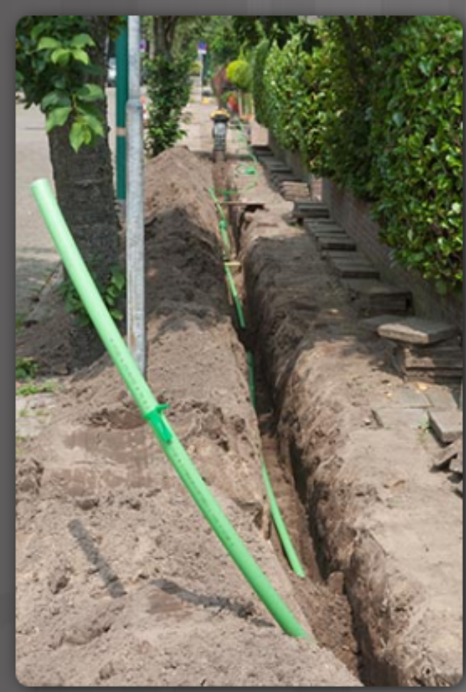
Select a Broadband Connection Comparing Broadband Solutions
Factors to consider in selecting a broadband solution:
Cable - Bandwidth shared by many users, slow data rates during high-usage hours.
DSL - Limited bandwidth that is distance sensitive (in relation to the ISP’s central office).
Fiber-to-the-Home - Requires fiber installation directly to the home.
Cellular/Mobile - Coverage is often an issue.
Wi-Fi Mesh - Most municipalities do not have a mesh network deployed.
Satellite - Expensive, limited capacity per subscriber
Notes:
3.1 – Remote Access Connections
3.1.2 – Select a Broadband Connection
3.1.2.1 – Comparing Broadband Solutions

Slide 23
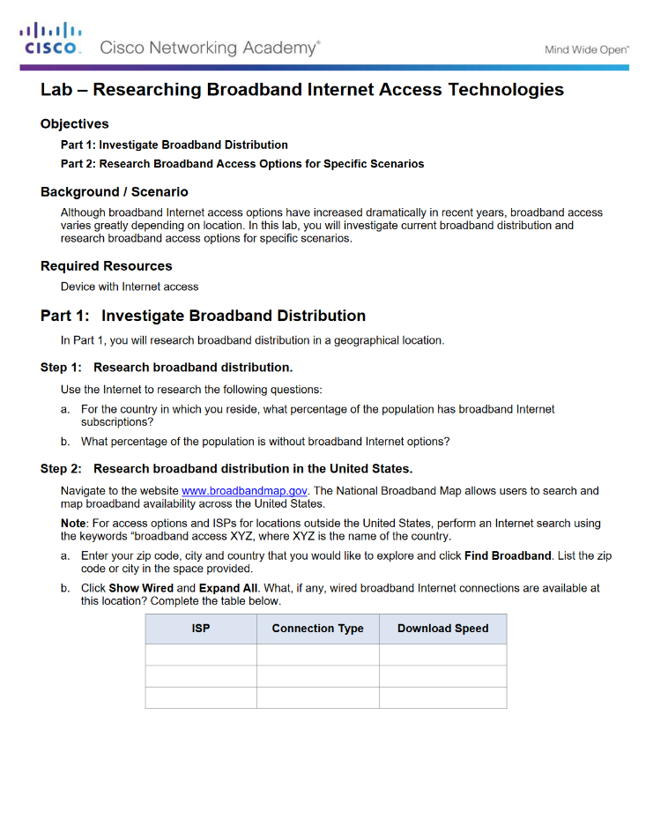
Select a Broadband Connection Lab - Researching Broadband Internet Access Technologies
Notes:
3.1 – Remote Access Connections
3.1.2 – Select a Broadband Connection
3.1.2.2 – Lab - Researching Broadband Internet Access Technologies

Slide 24
3.2 PPPoE
Notes:
3 – Branch Connections
3.2 – PPPoE

Slide 25
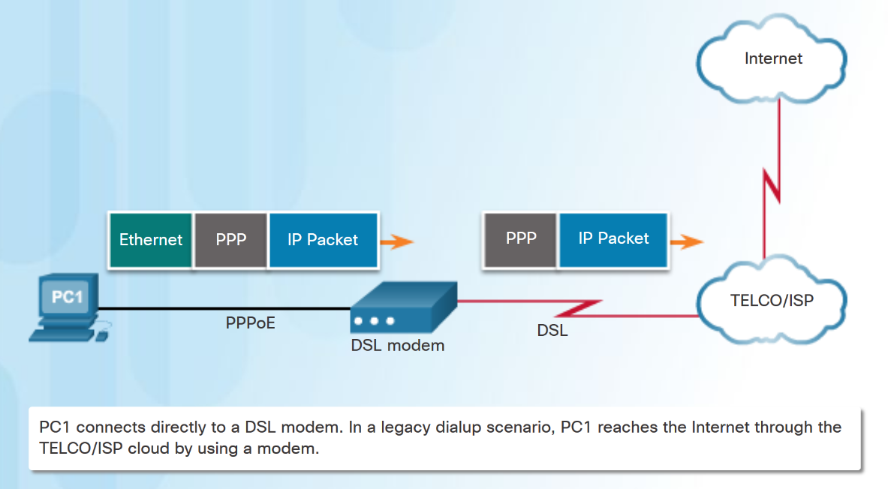
PPPoE Overview PPPoE Motivation
PPP can be used on all serial links including those links created with dial-up analog and ISDN modems.
ISPs often use PPP as the data link protocol over broadband connections.
ISPs can use PPP to assign each customer one public IPv4 address.
PPP supports CHAP authentication.
Ethernet links do not natively support PPP.
PPP over Ethernet (PPPoE) provides a solution to this problem.
PPP Frames Over An Ethernet Connection
Notes:
3.2 – PPPoE
3.2.1 – PPPoE Overview
3.2.1.1 – PPPoE Motivation

Slide 26
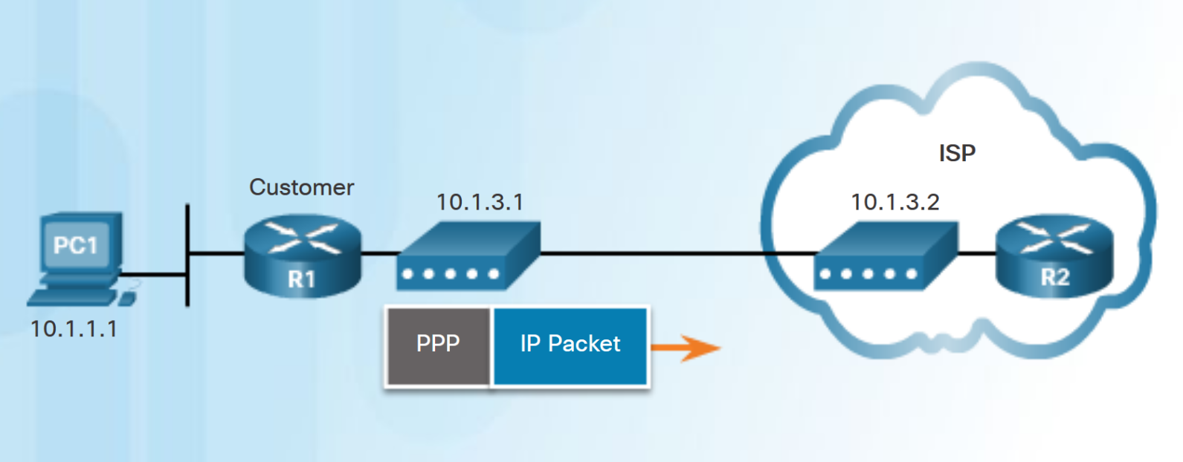
PPPoE Overview PPPoE Concepts
PPPoE creates a PPP tunnel over an Ethernet connection.
This allows PPP frames to be sent across the Ethernet cable to the ISP from the customer’s router.
Notes:
3.2 – PPPoE
3.2.1 – PPPoE Overview
3.2.1.2 – PPPoE Concepts

Slide 27
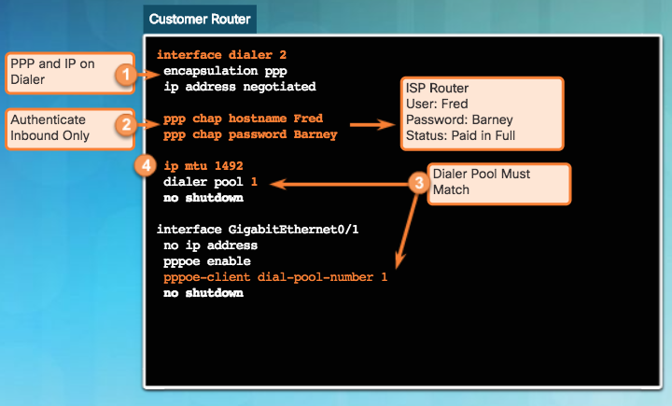
Implement PPPoE PPPoE Configuration
To create the PPP tunnel a dialer interface is configured.
Use interface dialer number command
The PPP CHAP is then configured. Use ppp chap hostname name and ppp chap password password.
The physical Ethernet interface connected to the DSL modem is enabled with the command pppoe enable interface configuration command.
Dialer interface is linked to the Ethernet interface with the dialer pool and pppoe-client interface configuration commands.
The MTU should be set to 1492 to accommodate PPPoE headers.
Notes:
3.2 – PPPoE
3.2.2 – Implement PPPoE
3.2.2.1 – PPPoE Configuration

Slide 28
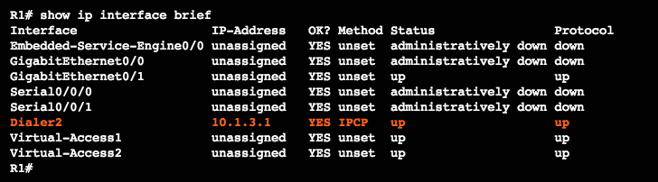
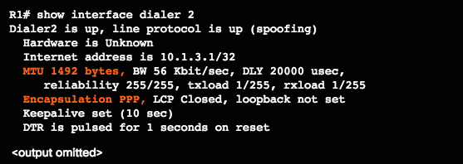
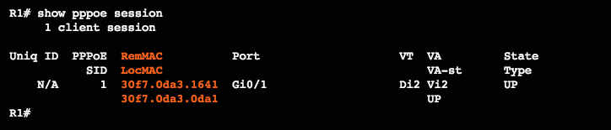
Implement PPPoE PPPoE Verification
Use the following commands to verify PPPoE:
show ip interface brief - verify the IPv4 address automatically assigned.
show interface dialer - verifies the MTU and PPP encapsulation.
show ip route
show pppoe session - displays information about currently active PPPoE sessions.
Notes:
3.2 – PPPoE
3.2.2 – Implement PPPoE
3.2.2.2 – PPPoE Verification

Slide 29
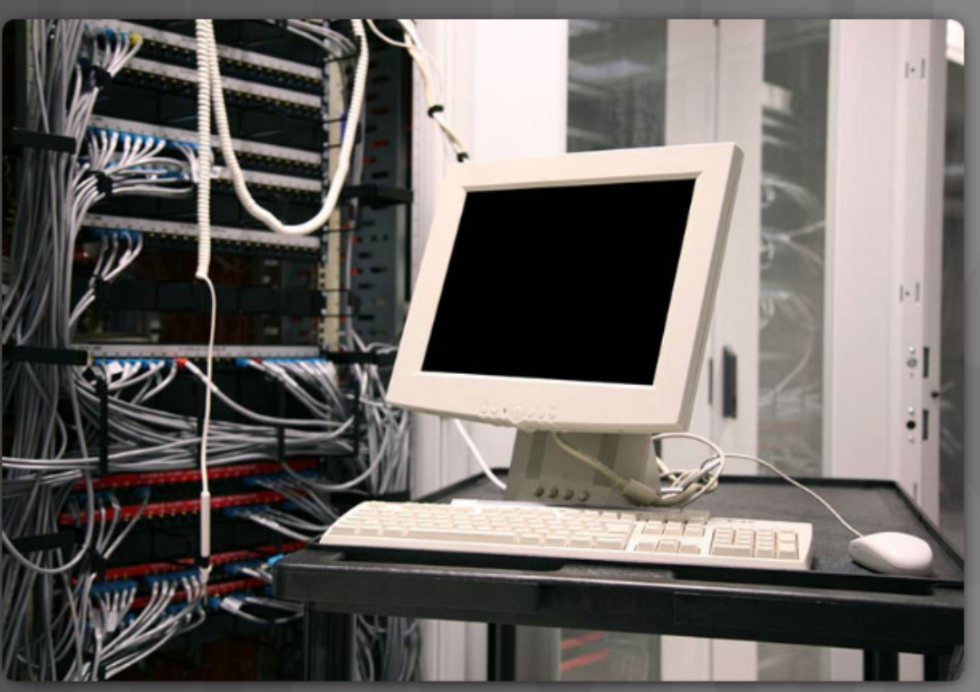
Implement PPPoE PPPoE Troubleshooting
The following are possible causes of problems with PPPoE:
Failure in the PPP negotiation process
Failure in the PPP authentication process
Failure to adjust the TCP maximum segment size
Notes:
3.2 – PPPoE
3.2.2 – Implement PPPoE
3.2.2.3 – PPPoE Troubleshooting

Slide 30
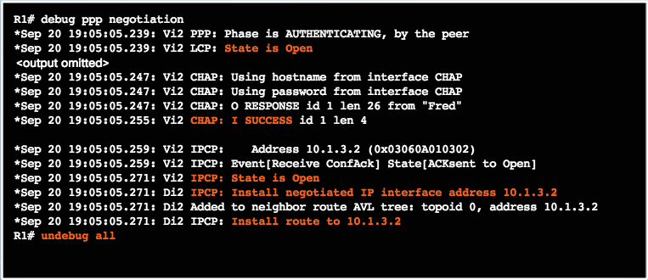
Implement PPPoE PPPoE Negotiation
Use the debug ppp negotiation command to verify PPP negotiation.
Four possible points of failure in PPP negotiation:
No response from the remote device.
Link Control Protocol (LCP) not open.
Authentication failure.
IP Control Protocol (IPCP) failure.
Notes:
3.2 – PPPoE
3.2.2 – Implement PPPoE
3.2.2.4 – PPPoE Negotiation

Slide 31
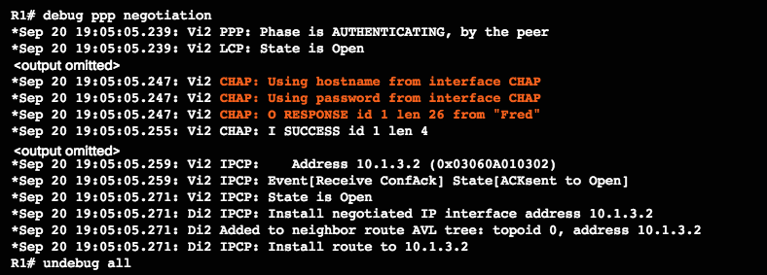
Implement PPPoE PPPoE Authentication
Verify that the CHAP username and password are correct using debug ppp negotiation command.
Notes:
3.2 – PPPoE
3.2.2 – Implement PPPoE
3.2.2.5 – PPPoE Authentication

Slide 32
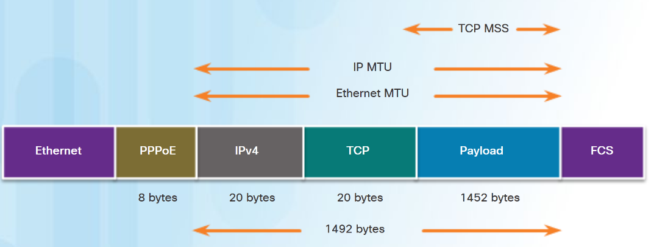
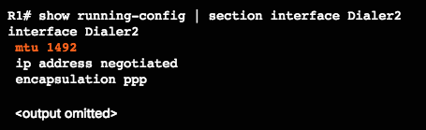

Implement PPPoE PPPoE MTU Size
Adjusted maximum segment size with PPPoE Header
PPPoE supports an MTU of only 1492 bytes in order to accommodate the additional 8-byte PPPoE header.
Use show running-config command to verify PPPoE MTU.
The ip tcp adjust-mss max-segment-size interface command prevents TCP sessions from being dropped by adjusting the MSS value during the TCP 3-way handshake.
Notes:
3.2 – PPPoE
3.2.2 – Implement PPPoE
3.2.2.6 – PPPoE MTU Size

Slide 33
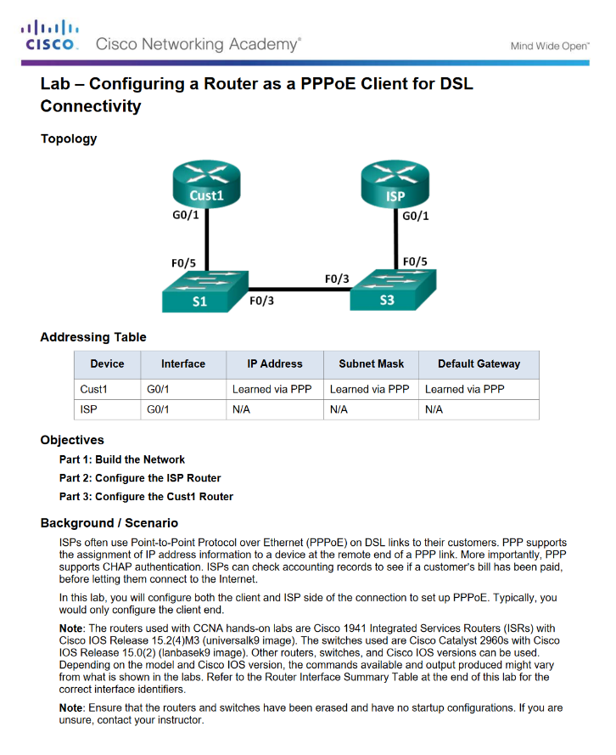
Implement PPPoE Lab - Configuring a Router as a PPPoE Client for DSL Connectivity
Notes:
3.2 – PPPoE
3.2.2 – Implement PPPoE
3.2.2.7 – Lab - Configuring a Router as a PPPoE Client for DSL Connectivity

Slide 34
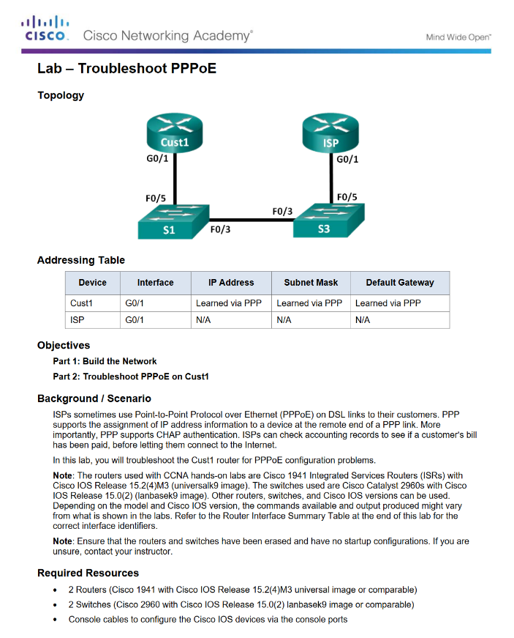
Implement PPPoE Lab - Troubleshoot PPPoE
Notes:
3.2 – PPPoE
3.2.2 – Implement PPPoE
3.2.2.8 – Lab - Troubleshoot PPPoE

Slide 35
3.3 VPNs
Notes:
3 – Branch Connections
3.3 – VPNs

Slide 36
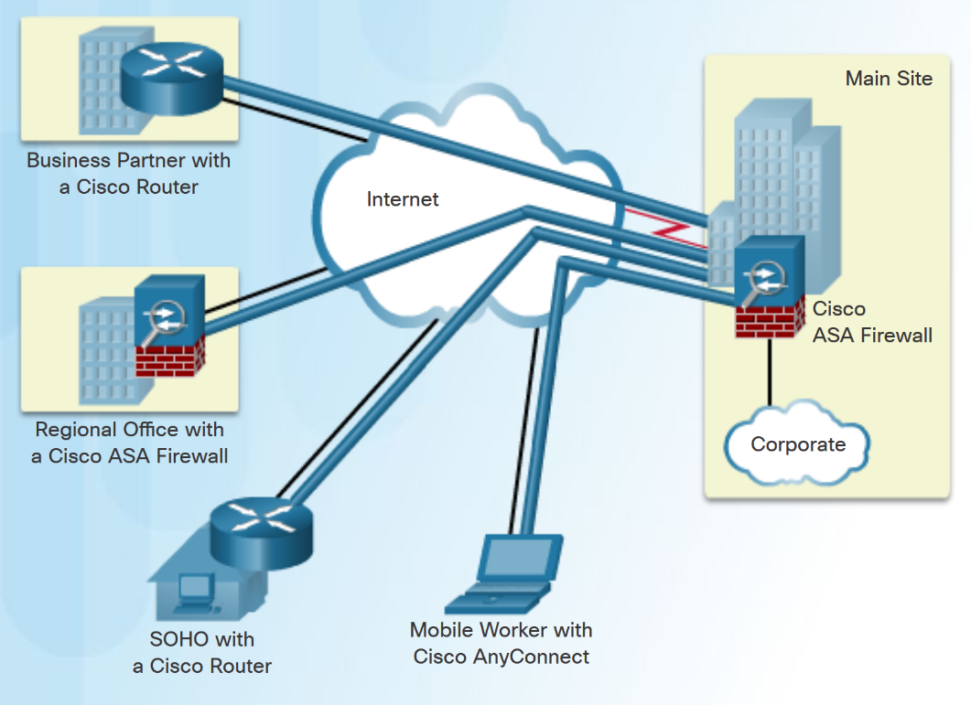
Fundamentals of VPNs Introducing VPNs
A VPN is a private network created via tunneling over a public network, usually the Internet.
A secure implementation of VPN with encryption, such as IPsec VPNs, is what is usually meant by virtual private networking.
To implement VPNs, a VPN gateway is necessary - could be a router, a firewall, or a Cisco Adaptive Security Appliance (ASA).
Notes:
3.3 – VPNs
3.3.1 – Fundamentals of VPNs
3.3.1.1 – Introducing VPNs

Slide 37
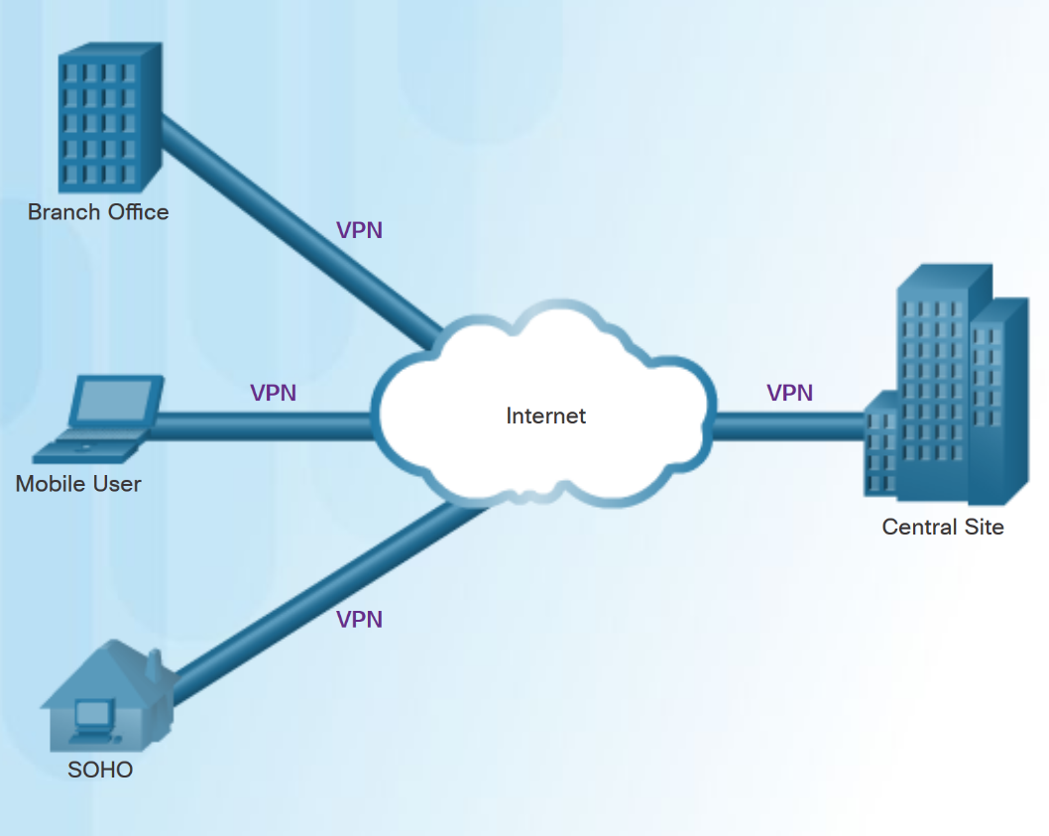
Fundamentals of VPNs Benefits of VPNs
The benefits of a VPN include the following:
Cost savings - VPNs enable organizations to use cost-effective, high-bandwidth technologies, such as DSL to connect remote offices and remote users to the main site.
Scalability - Organizations are able to add large amounts of capacity without adding significant infrastructure.
Compatibility with broadband technology - Allow mobile workers and telecommuters to take advantage of high-speed, broadband connectivity.
Security - VPNs can use advanced encryption and authentication protocols.
Notes:
3.3 – VPNs
3.3.1 – Fundamentals of VPNs
3.3.1.2 – Benefits of VPNs

Slide 38
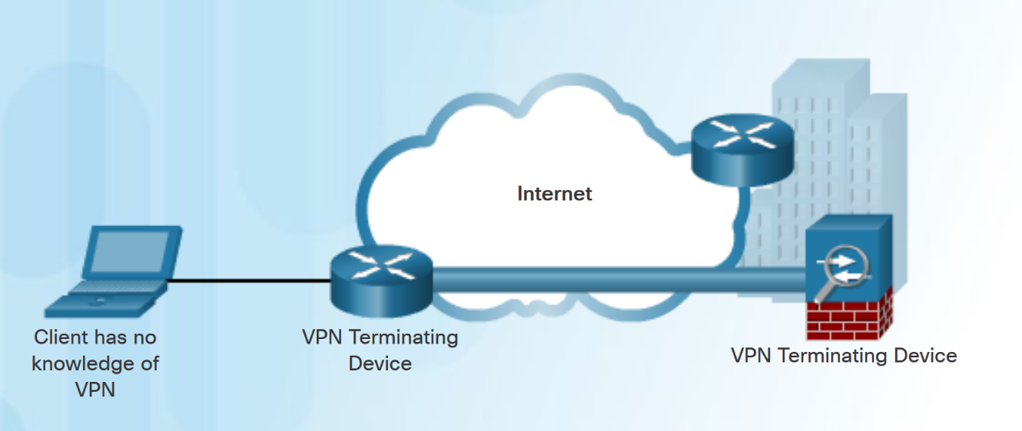
Types of VPNs Site-to-Site VPNs
Site-to-site VPNs connect entire networks to each other, for example, connecting a branch office network to a company headquarters network.
In a site-to-site VPN, end hosts send and receive normal TCP/IP traffic through a VPN “gateway”.
The VPN gateway is responsible for encapsulating and encrypting outbound traffic.
Notes:
3.3 – VPNs
3.3.2 –Types of VPNs
3.3.2.1 – Site-to-Site VPNs

Slide 39
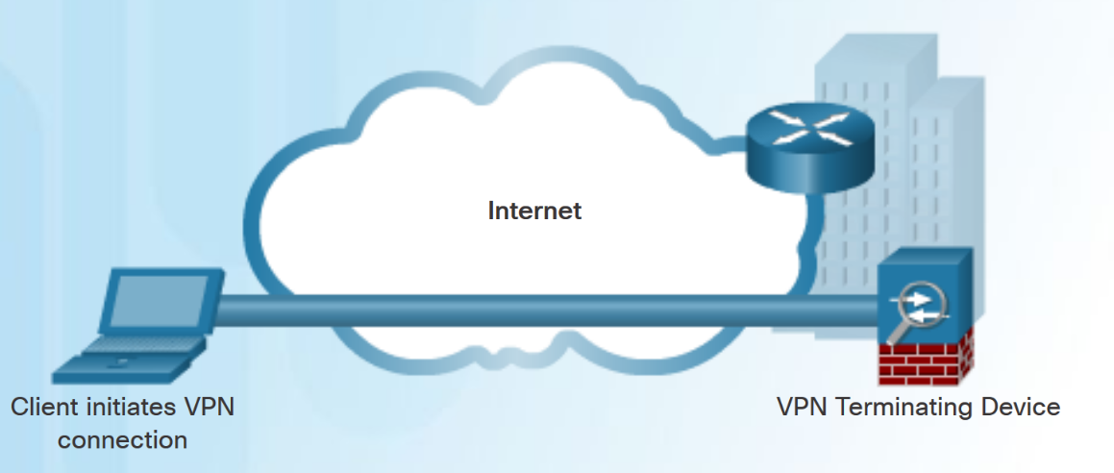
Types of VPNs Remote Access VPNs
A remote-access VPN supports the needs of telecommuters, mobile users, and extranet traffic.
Allows for dynamically changing information, and can be enabled and disabled.
Used to connect individual hosts that must access their company network securely over the Internet.
VPN client software may need to be installed on the mobile user’s end device.
Notes:
3.3 – VPNs
3.3.2 –Types of VPNs
3.3.2.2 – Remote Access VPNs

Slide 40
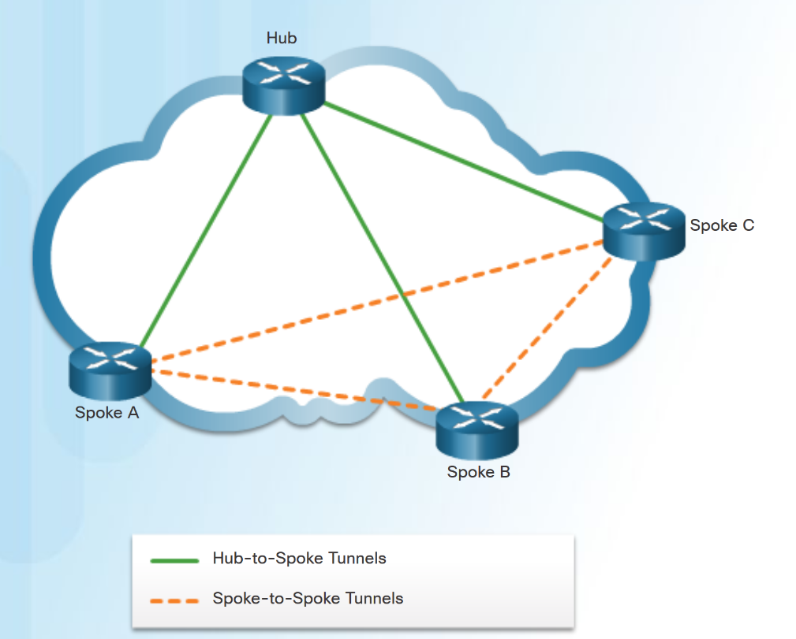
Types of VPNs DMVPN
Dynamic Multipoint VPN (DMVPN) is a Cisco software solution for building multiple VPNs.
DMVPN is built using the following technologies:
Next Hop Resolution Protocol (NHRP) - NHRP creates a distributed mapping database of public IP addresses for all tunnel spokes.
Multipoint Generic Routing Encapsulation (mGRE) tunnels - An mGRE tunnel interface allows a single GRE interface to support multiple IPsec tunnels.
IP Security (IPsec) encryption - provides secure transport of private information over public networks.
Notes:
3.3 – VPNs
3.3.2 –Types of VPNs
3.3.2.3 – DMVPN

Slide 41
3.4 GRE
Notes:
3 – Branch Connections
3.4 – GRE

Slide 42
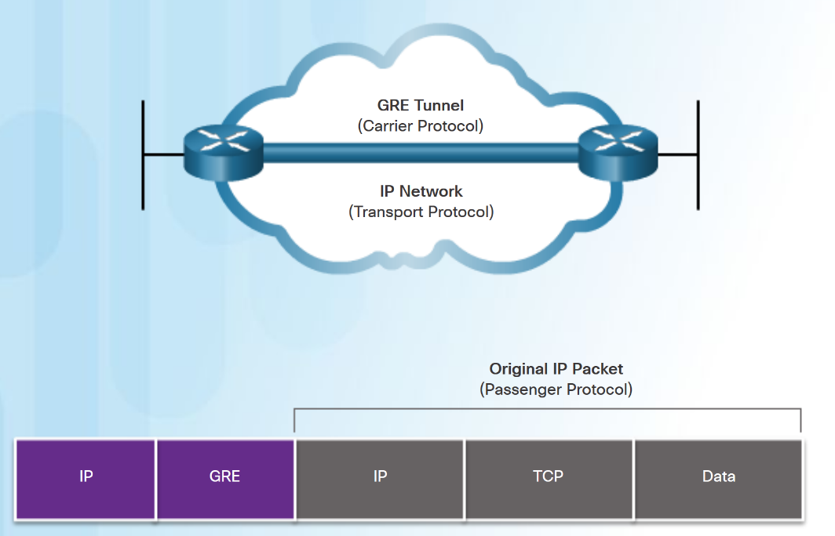
GRE Overview GRE Introduction
Generic Routing Encapsulation (GRE) is a non-secure, site-to-site VPN tunneling protocol.
Developed by Cisco.
GRE manages the transportation of multiprotocol and IP multicast traffic between two or more sites
A tunnel interface supports a header for each of the following:
An encapsulated protocol - or passenger protocol, such as IPv4, IPv6.
An encapsulation protocol - or carrier protocol, such as GRE.
A transport delivery protocol, such as IP.
Notes:
3.4 – GRE
3.4.1 –GRE Overview
3.4.1.1 – GRE Introduction

Slide 43
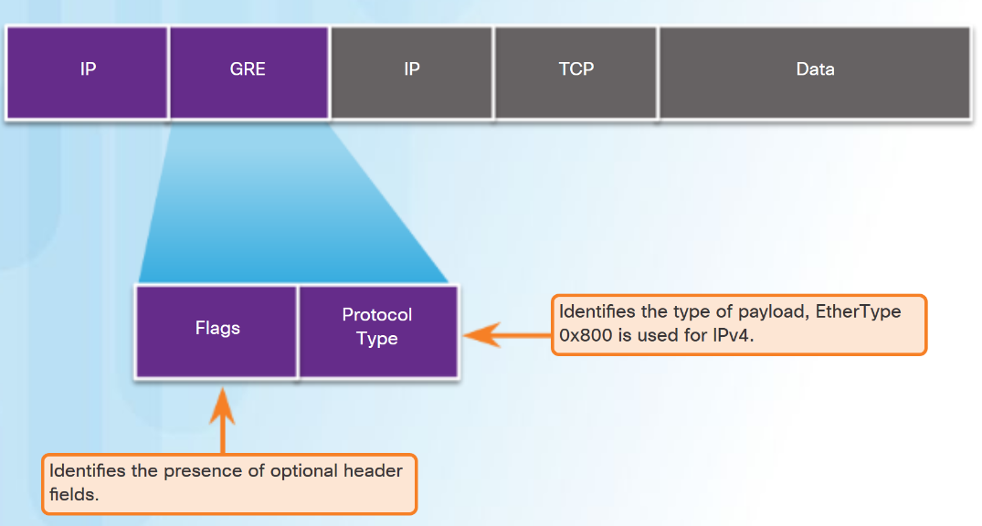
GRE Overview GRE Characteristics
GRE is defined as an IETF standard (RFC 2784).
In the outer IP header, 47 is used in the protocol field.
GRE encapsulation uses a protocol type field in the GRE header to support the encapsulation of any OSI Layer 3 protocol.
GRE is stateless.
GRE does not include any strong security mechanisms.
GRE header, together with the tunneling IP header, creates at least 24 bytes of additional overhead for tunneled packets.
Notes:
3.4 – GRE
3.4.1 –GRE Overview
3.4.1.2 – GRE Characteristics

Slide 44
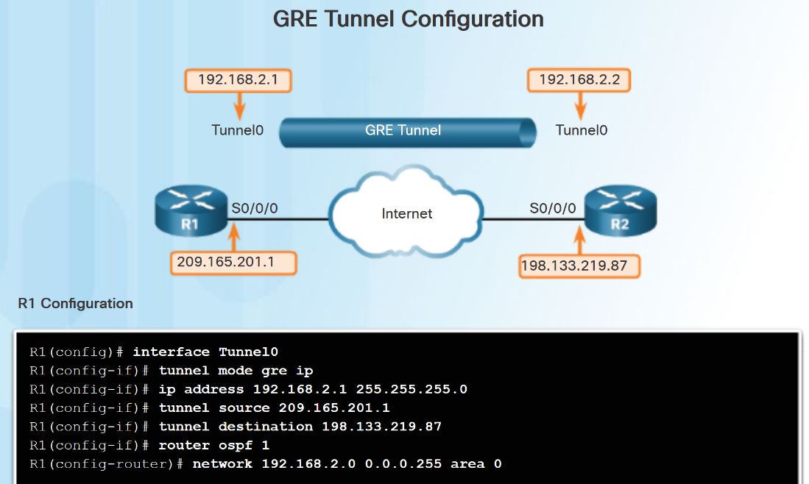
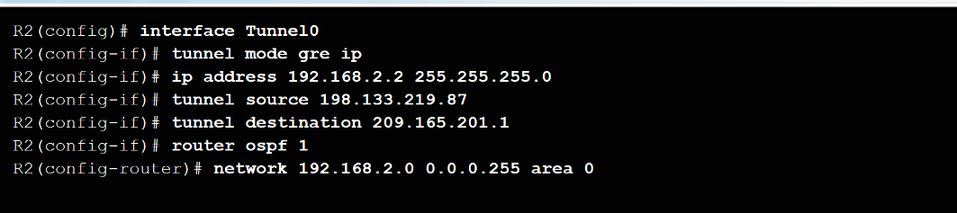
Implement GRE Configure GRE
Five steps to configuring a GRE tunnel:
Step 1. Create a tunnel interface using the interface tunnel number command.
Step 2. Configure an IP address for the tunnel interface. (Usually a private address)
Step3. Specify the tunnel source IP address.
Step 4. Specify the tunnel destination IP address.
Step 5. (Optional) Specify GRE tunnel mode as the tunnel interface mode.
Note: The tunnel source and tunnel destination commands reference the IP addresses of the preconfigured physical interfaces.
Notes:
3.4 – GRE
3.4.2 –Implement GRE
3.4.2.1 – Configure GRE

Slide 45
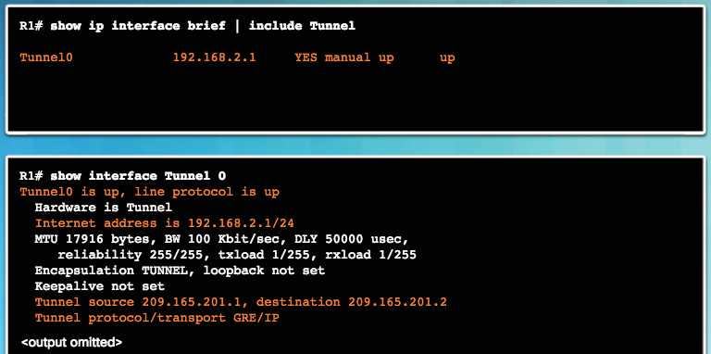
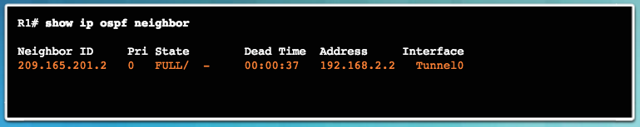
Implement GRE Verify GRE
Use the show ip interface brief command to verify that the tunnel interface is up.
Use the show interface tunnel command to verify the state of the tunnel.
Use the show ip ospf neighbor command to verify that an OSPF adjacency has been established over the tunnel interface.
Notes:
3.4 – GRE
3.4.2 –Implement GRE
3.4.2.2 – Verify GRE

Slide 46
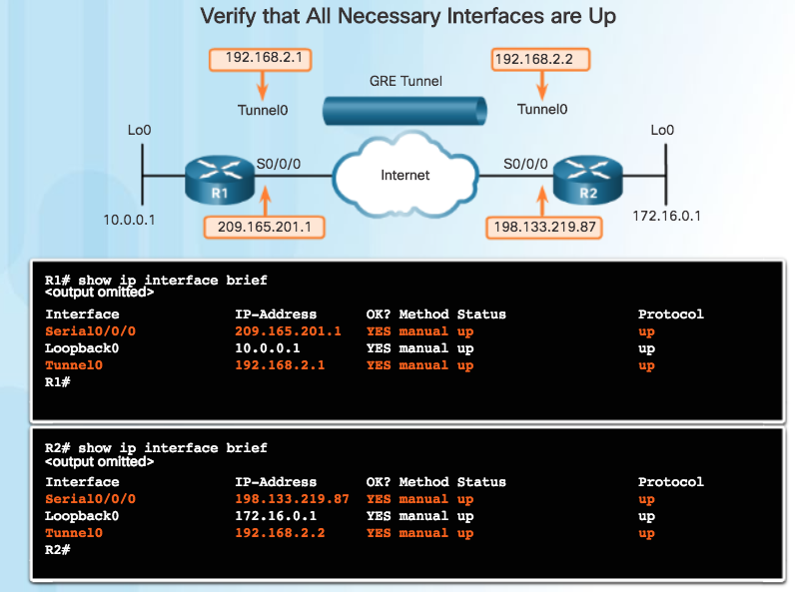
Implement GRE Troubleshoot GRE
Issues with GRE are usually due to one or more of the following:
The tunnel interface IP addresses are not on the same network or the subnet masks do not match. Use the show ip interface brief command.
The interfaces for the tunnel source and/or destination are not configured with the correct IP address or are down. Use the show ip interface brief command.
Static or dynamic routing is not properly configured. Use show ip route or show ip ospf neighbor.
Notes:
3.4 – GRE
3.4.2 –Implement GRE
3.4.2.3 – Troubleshoot GRE

Slide 47
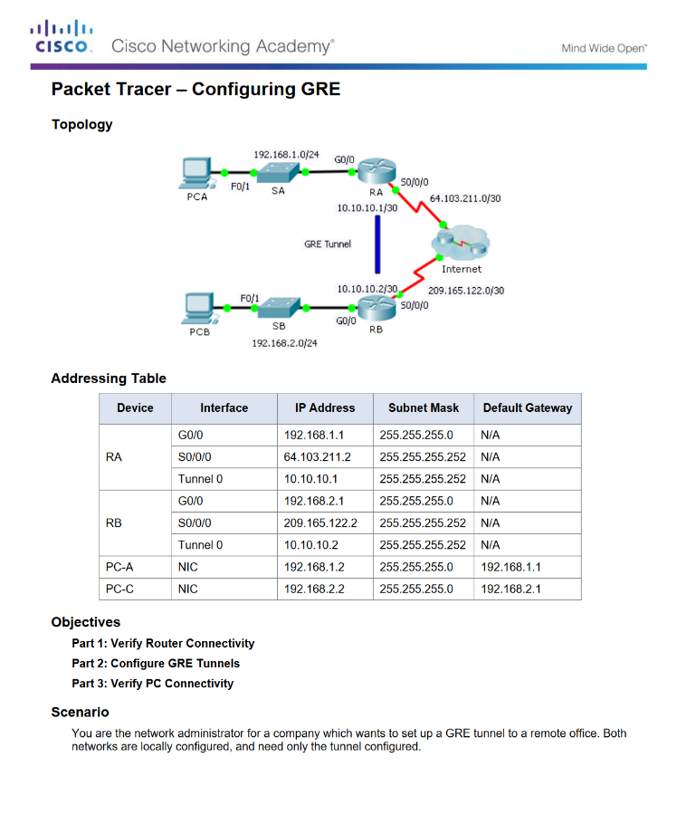
Implement GRE Packet Tracer - Configuring GRE
Notes:
3.4 – GRE
3.4.2 –Implement GRE
3.4.2.4 – Packet Tracer - Configuring GRE

Slide 48
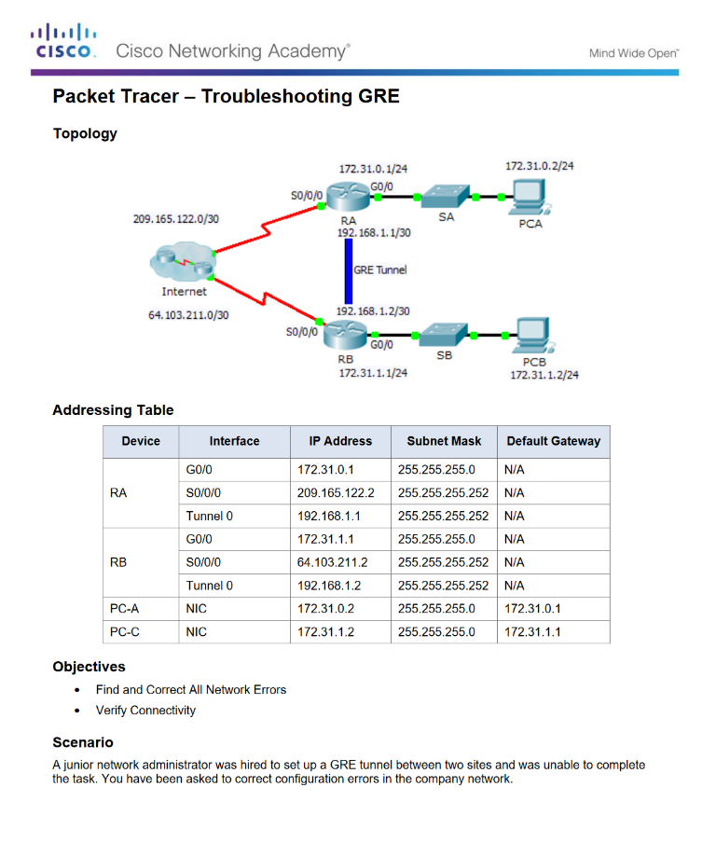
Implement GRE Packet Tracer - Troubleshooting GRE
Notes:
3.4 – GRE
3.4.2 –Implement GRE
3.4.2.5 – Packet Tracer - Troubleshooting GRE

Slide 49
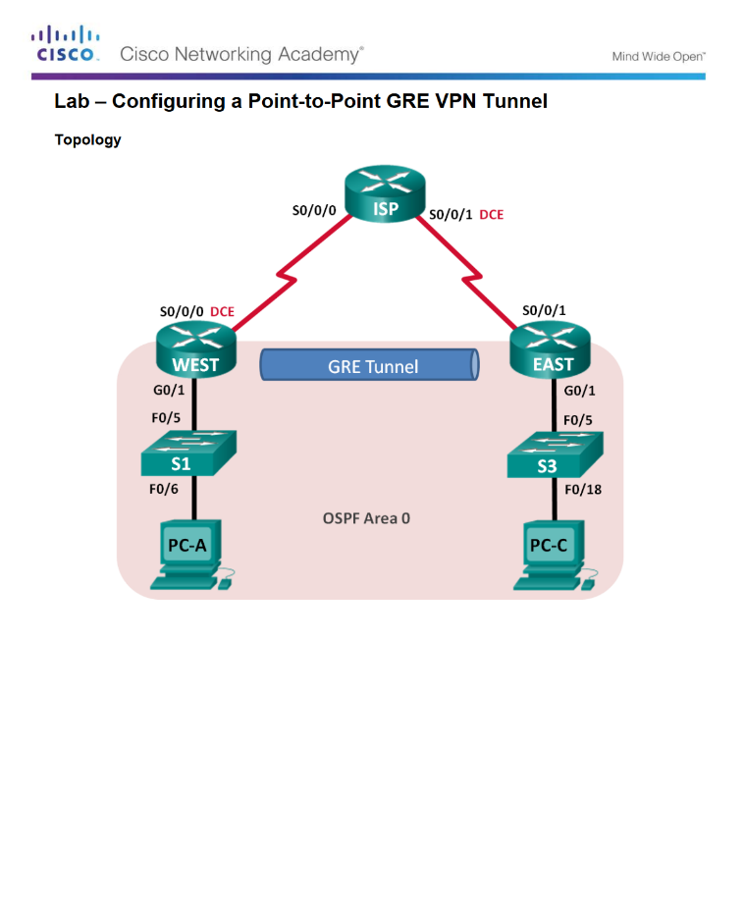
Implement GRE Lab – Configuring a Point-to-Point GRE VPN Tunnel
Notes:
3.4 – GRE
3.4.2 –Implement GRE
3.4.2.6 – Lab – Configuring a Point-to-Point GRE VPN Tunnel

Slide 50
3.5 eBGP
Notes:
3 – Branch Connections
3.5 – eBGP

Slide 51
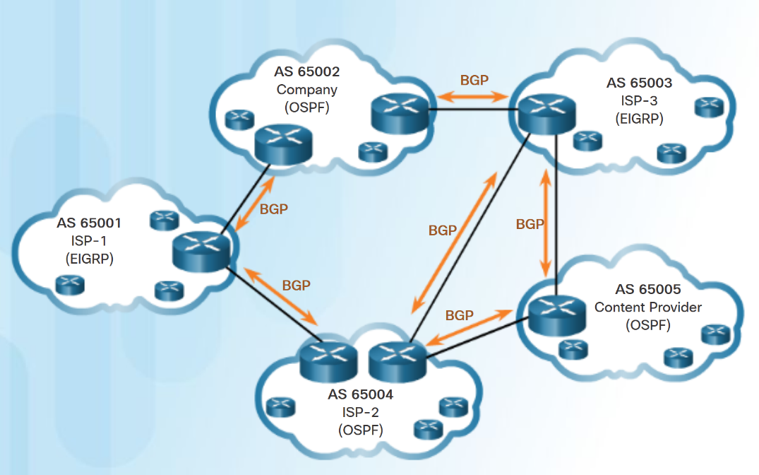
BGP Overview IGP and EGP Routing Protocols
IGPs are used to exchange routing information within a company network or an autonomous system (AS).
An Exterior Gateway Protocol (EGP) is used for the exchange of routing information between autonomous systems, such as ISPs.
Border Gateway Protocol (BGP) is an Exterior Gateway Protocol (EGP).
Every AS is assigned a unique 16-bit or 32-bit AS number which uniquely identifies it on the Internet.
Notes:
3.5 – eBGP
3.5.1 –BGP Overview
3.5.1.1 – IGP and EGP Routing Protocols

Slide 52
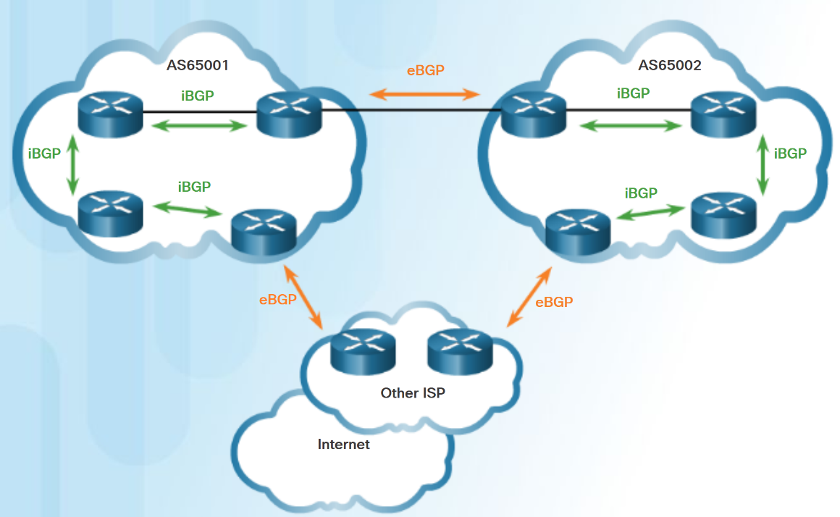
BGP Overview eBGP and iBGP
External BGP (eBGP) – External BGP is the routing protocol used between routers in different autonomous systems.
Internal BGP (iBGP) - Internal BGP is the routing protocol used between routers in the same AS.
Two routers exchanging BGP routing information are known as BGP peers
Notes:
3.5 – eBGP
3.5.1 –BGP Overview
3.5.1.2 – eBGP and iBGP

Slide 53
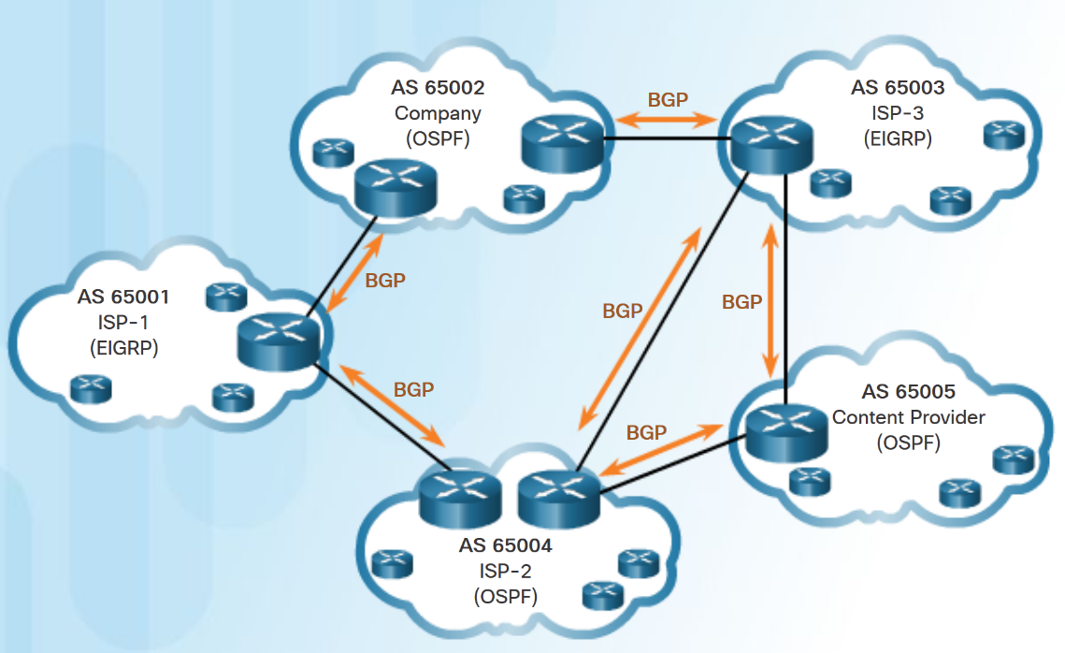
BGP Design Considerations When to use BGP
BGP is used when an AS has connections to multiple autonomous systems. This is known as multi-homed.
A misconfiguration of a BGP router could have negative effects throughout the Internet.
Notes:
3.5 – eBGP
3.5.2 –BGP Design Considerations
3.5.2.1 – When to use BGP

Slide 54
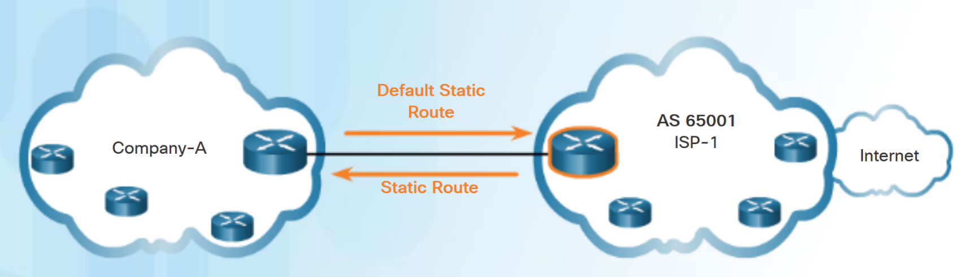
BGP Design Considerations When not to use BGP
BGP should not be used when one of the following conditions exist:
There is a single connection to the Internet or another AS. Known as single-homed.
When there is a limited understanding of BGP.
Note: Although it is recommended only in unusual situations, for the purposes of this course, you will configure single-homed BGP.
Notes:
3.5 – eBGP
3.5.2 –BGP Design Considerations
3.5.2.2 – When not to use BGP

Slide 55
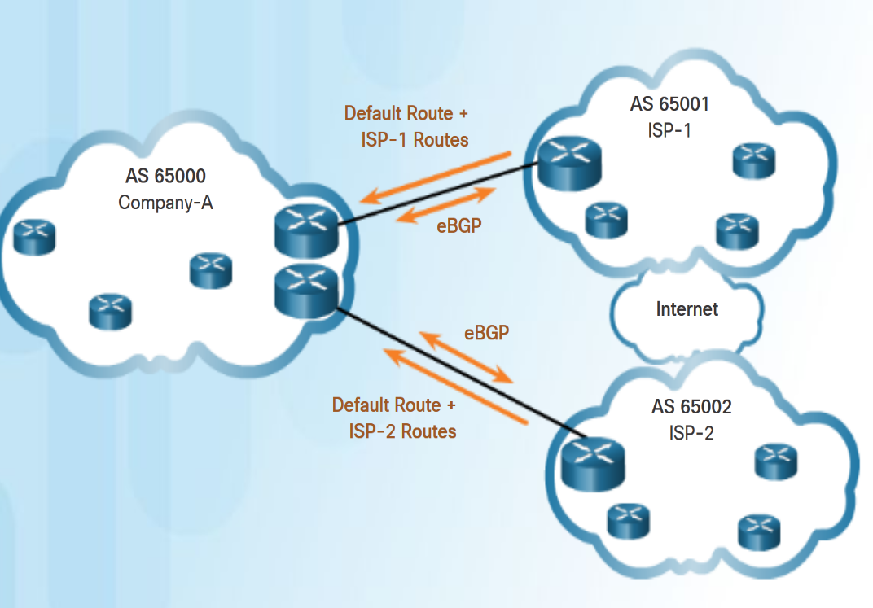
BGP Design Considerations BGP Options
Three common ways an organization can implement BGP in a multi-homed environment:
Default Route Only
Default Route and ISP Routes
All Internet Routes (this would include
routes to over 550,000 networks)
Notes:
3.5 – eBGP
3.5.2 –BGP Design Considerations
3.5.2.3 – BGP Options

Slide 56
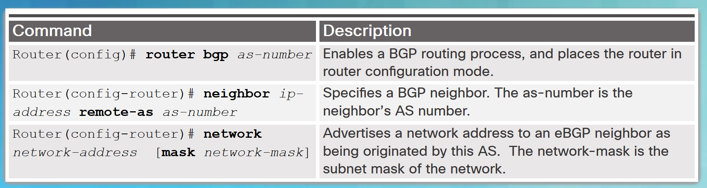
eBGP Branch Configuration Steps to Configure eBGP
To implement eBGP:
Enable BGP routing.
Configure BGP neighbor(s) (peering)
Advertise network(s) originating from this AS.
Notes:
3.5 – eBGP
3.5.3 –eBGP Branch Configuration
3.5.3.1 – Steps to Configure eBGP

Slide 57
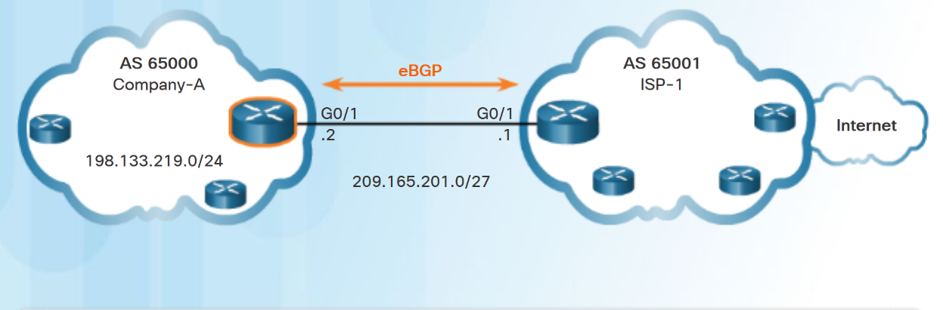

eBGP Branch Configuration BGP Sample Configuration
The router bgp as-number global configuration command enables BGP and identifies the AS number.
The neighbor ip-address remote-as as-number router configuration command identifies the BGP peer and its AS number.
The network network-address [mask network-mask] router configuration command enters the network-address into the local BGP table.
Note: The network-address used in the network command does not have to be a directly connected network.
Company-A(config)#router bgp 65000
Company-A(config-router)#neighbor 209.165.201.1 remote-as 65001
Company-A(config-router)#network 198.133.219.0 mask 255.255.255.0
Notes:
3.5 – eBGP
3.5.3 –eBGP Branch Configuration
3.5.3.2 – BGP Sample Configuration

Slide 58
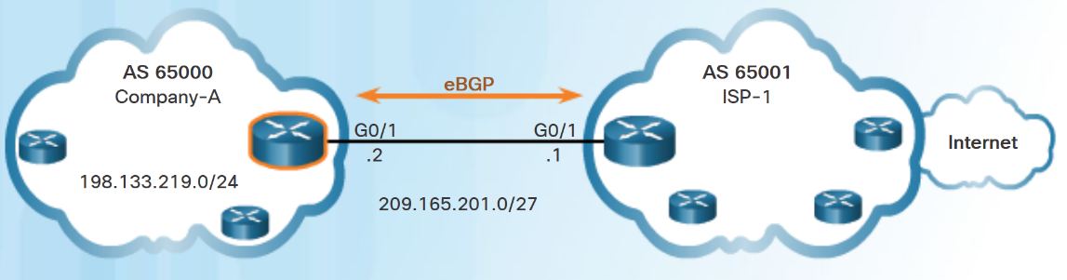
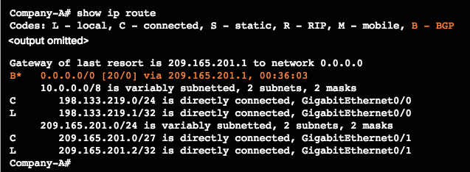
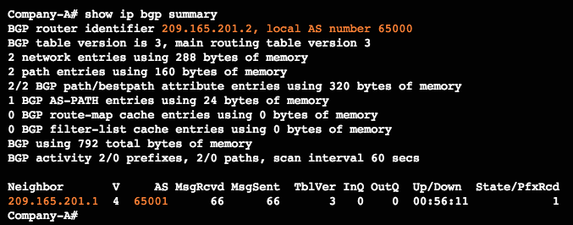
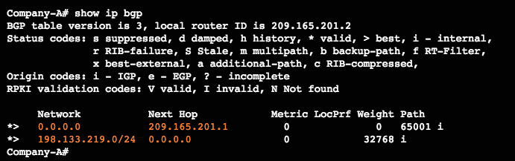
eBGP Branch Configuration Verify eBGP
Three commands to verify eBGP:
show ip route
show ip bgp
show ip bgp summary
Notes:
3.5 – eBGP
3.5.3 – eBGP Branch Configuration
3.5.3.3 – Verify eBGP

Slide 59
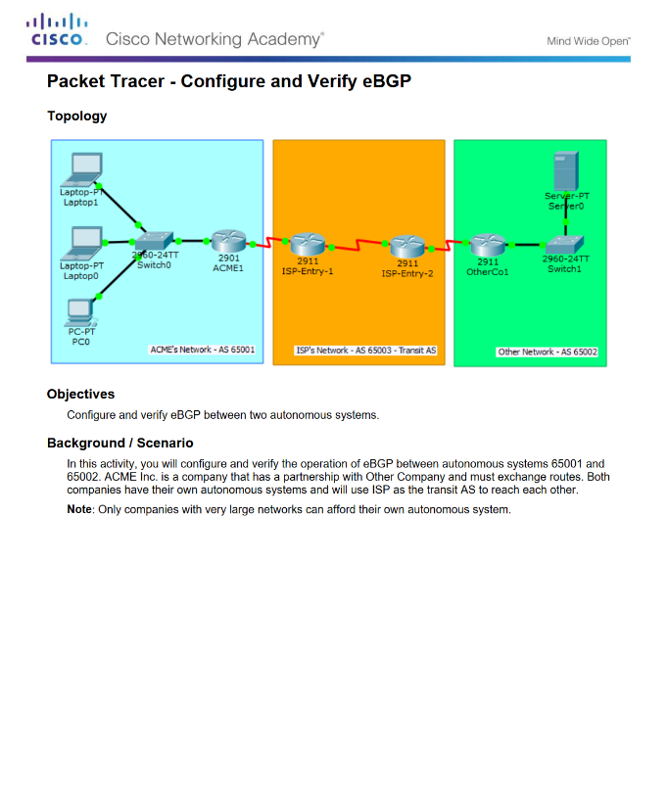
eBGP Branch Configuration Packet Tracer - Configure and Verify eBGP
Notes:
3.5 – eBGP
3.5.3 –eBGP Branch Configuration
3.5.3.4 – Packet Tracer - Configure and Verify eBGP

Slide 60
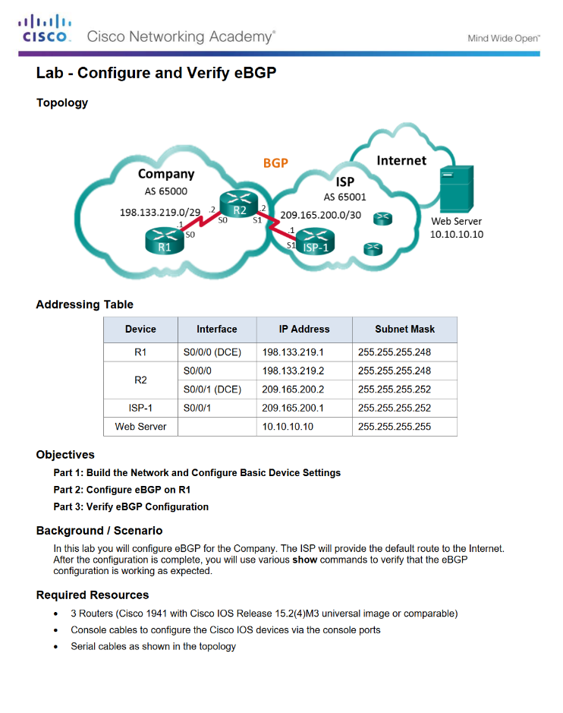
eBGP Branch Configuration Lab - Configure and Verify eBGP
Notes:
3.5 – eBGP
3.5.3 –eBGP Branch Configuration
3.5.3.5 – Lab - Configure and Verify eBGP

Slide 61
3.6 Chapter Summary
Notes:
3 – Branch Connections
3.6 – Summary

Slide 62
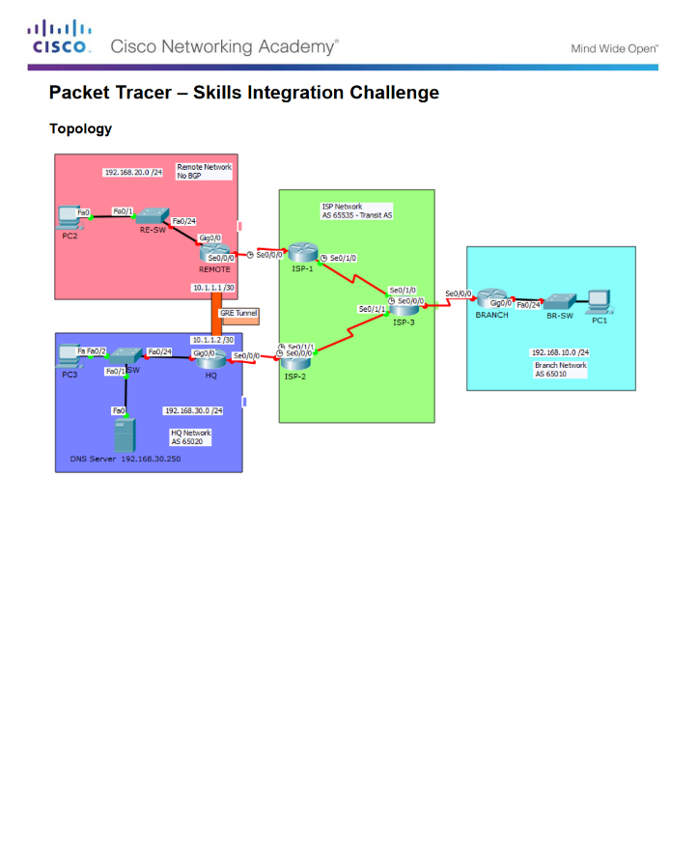
Conclusion Packet Tracer - Skills Integration Challenge
Notes:
3.6 – Summary
3.6.1 – Conclusion
3.6.1.2 - Packet Tracer - Skills Integration Challenge

Slide 63
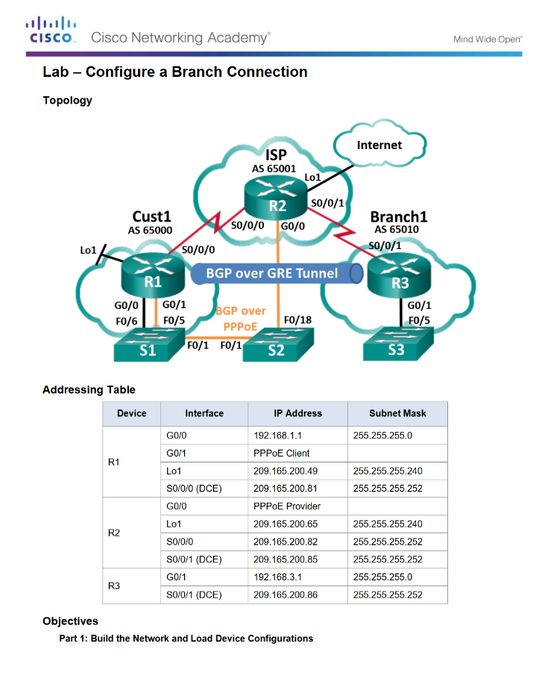
Conclusion Lab - Configure a Branch Connection
Notes:
3.6 – Summary
3.6.1 – Conclusion
3.6.1.3 - Lab - Configure a Branch Connection

Slide 64
Conclusion Chapter 3: Branch Connections
Select broadband remote access technologies to support business requirements.
Configure a Cisco router with PPPoE.
Explain how VPNs secure site-to-site and remote access connectivity.
Implement a GRE tunnel.
Implement eBGP in a single-homed remote access network.
Notes:
3.6 – Summary
3.6.1 – Conclusion
3.6.1.4 - Chapter 3: Branch Connections

Slide 65
Chapter 3: Branch Connections New Terms and Commands
PPP over Ethernet (PPPoE) Internet Protocol Security (IPsec) Border Gateway Protocol (BGP) radio frequency (RF) hybrid fiber-coaxial (HFC) Data over Cable Service Interface Specification (DOCSIS) Antenna Site Transportation Network distribution network central office (co) Amplifier Subscriber Drop Node downstream | upstream Asymmetric DSL (ADSL) symmetric DSL (SDSL) DSL Transceiver DSL micro filter Cellular/mobile dialer interface maximum transmission unit (MTU) maximum segment size (MSS) VPN gateway telecommuters VPN client software Cisco AnyConnect Secure Mobility Client Dynamic Multipoint VPN (DMVPN) Next Hop Resolution Protocol (NHRP)
Notes:
New Terms and Commands

Slide 66
Chapter 3: Branch Connections New Terms and Commands (Cont.)
Next Hop Server (NHS) Next Hop Clients (NHCs) spoke-to-spoke Multipoint Generic Routing Encapsulation (mGRE) Passenger protocol Carrier protocol Transport protocol Secure Sockets Layer (SSL) AS number (ASN) path vector routing protocol External BGP (eBGP) Internal BGP (iBGP) | multi-homed single-homed BGP peers Network Address Translation (NAT)
Notes:
New Terms and Commands

